Slide 1
NAME : RAMYA S
REGISTER NUMBER : 412721205037
COLLEGE : TAGORE ENGINEERING COLLEGE

Slide 2
PROJECT TITLE
“Emotion Recognition Using Long Short-Term Memory(LSTM) Networks”

Slide 3
AGENDA
PROBLEM STATEMENT
PROJECT OVERVIEW
WHO ARE THE END USERS
SOLUTION AND ITS VALUE PROPOSITION
THE WOW IN YOUR SOLUTION
MODELLING
RESULTS

Slide 4
PROBLEM STATEMENT
Emotion recognition is a critical aspect of human-computer interaction, with applications ranging from customer sentiment analysis to mental health diagnostics.
Traditional methods often rely on handcrafted features and shallow learning algorithms, which may struggle to capture the complex temporal dependencies inherent in emotional expression. Long Short-Term Memory (LSTM) networks, a type of recurrent neural network (RNN), offer promise in modeling sequential data and have shown success in various time-series tasks, including natural language processing and speech recognition.
However, applying LSTM networks to emotion recognition presents several challenges, One primary challenge is the need for labeled data, which is often scarce and expensive to obtain, especially for emotional datasets.
Additionally, emotional expressions are inherently subjective and context-dependent, making it difficult to develop a universally applicable model.
Furthermore, the interpretation of emotional states can vary across individuals and cultures, necessitating robust and adaptable models.

Slide 5
PROJECT OVERVIEW
Text-based emotion recognition is a dynamic and evolving field within Natural Language Processing (NLP) that focuses on deciphering diverse emotional states expressed within textual content.
It involves the development of algorithms and models capable of understanding and categorizing the emotional content present in written language, ranging from social media posts and customer reviews to literary texts and email communications.

Slide 6
WHO ARE THE END USERS
Individuals: People may use emotion recognition systems powered by LSTM networks for personal development, mental health tracking, or self-awareness purposes. For example, individuals might use emotion recognition apps or wearable devices to monitor their emotional states throughout the day.
Therapists and Mental Health Professionals: Therapists and mental health professionals can utilize emotion recognition technology to assist in diagnosing, monitoring, and treating various mental health conditions such as depression, anxiety, or PTSD. LSTM networks can help therapists analyze patients' emotional states over time and tailor interventions accordingly.
Educators: Educators may employ emotion recognition systems to better understand students' engagement levels, emotional responses to learning materials, and overall well-being. This information can inform instructional strategies and support interventions to enhance the learning experience.
Customer Service Representatives: Companies can integrate emotion recognition technology into customer service platforms to analyze customer sentiment during interactions. LSTM networks can help identify customers' emotional cues, allowing representatives to provide more personalized and empathetic responses.

Slide 7
5.Market Researchers: Market researchers can use emotion recognition systems to analyze consumer reactions to products, advertisements, or brand messaging. LSTM networks can help identify patterns in emotional responses, providing insights into consumer preferences and behavior.
6.Entertainment Industry: Developers of video games, virtual reality experiences, and interactive media may utilize emotion recognition technology to create more immersive and responsive content. LSTM networks can adapt gameplay or storylines based on players' emotional states, enhancing the overall entertainment experience.
7.Healthcare Providers: Healthcare providers can leverage emotion recognition systems to assess patients' emotional well-being and track changes over time. This information can be particularly useful in mental health assessments, chronic disease management, and rehabilitation programs.
8.Law Enforcement and Security Agencies: Emotion recognition technology can be employed by law enforcement and security agencies for various purposes, such as detecting suspicious behavior or assessing individuals' emotional states during interrogations or security screenings.

Slide 8
YOUR SOLUTION AND ITS VALUE PROPOSITION
PERSONALIZED MENTAL HEALTH MONITORING:
SOLUTION: Emotion Recognition Systems powered by LSTM networks can continuously monitor individuals emotional states through various modalities such as text,speech or facial expressions.
VALUE PROPOSITION:
This solution enables personalized mental health monitoring, allowing individuals to track their emotional well-being over time. It can provide early indications of potential mental health issues, facilitate self-reflection, and prompt proactive interventions or seeking professional help when needed.
2. ENHANCED CUSTOMER EXPERIENCE IN SERVICE INDUSTRIES:
SOLUTION: Service industries such as customer support or retail can deploy emotion recognition technology to analyze customers' emotional responses during interactions.
VALUE PROPOSITION:
By understanding customers' emotions, businesses can offer more empathetic and personalized service. Emotion recognition facilitates better customer engagement, leading to increased satisfaction, loyalty, and potentially higher sales.

Slide 9
3. EDUCATIONAL INSIGHTS AND ADAPTIVE LEARNING:
SOLUTION: Emotion recognition systems integrated into educational platforms can analyze students' emotional responses to learning materials and activities.
VALUE PROPOSITION: Educators gain insights into students' engagement levels, frustration, or confusion, allowing for personalized interventions and adaptive learning experiences. This enhances student motivation, learning outcomes, and overall educational effectiveness.
4. IMPROVED HUMAN – COMPUTER INTERACTION:
SOLUTION: Emotion recognition technology enables more natural and intuitive human-computer interactions by understanding users' emotional cues.
VALUE PROPOSITION: This solution enhances user experience across various applications such as virtual assistants, gaming, or virtual reality. Systems can adapt responses, content, or gameplay based on users' emotional states, leading to more engaging and immersive experiences.

Slide 10
THE WOW IN YOUR SOLUTION
The "wow" factor in the solution for emotion recognition using LSTM networks is its ability to accurately detect and analyze human emotions in real-time across multiple modalities. This includes text, speech, and facial expressions. The use of LSTM networks, known for their ability to capture long-term dependencies, ensures precise emotion recognition and allows for personalized insights into emotional states. Additionally, the solution emphasizes adaptability and scalability, ensuring its applicability across various industries and use cases. The integration of privacy protection measures enhances user trust, while the potential for insightful analytics enables data-driven decision-making, ultimately leading to improved outcomes and user experiences. Overall, the combination of advanced technology, real-time capabilities, and potential impact on well-being and organizational efficiency makes this solution truly impressive.

Slide 11
MODELLING
Model Choice: Utilize LSTM network, a type of Recurrent Neural Network (RNN)
Implementation : Implemented with Tensor flow
LSTM (Long Short-Term Memory) networks, implemented using TensorFlow, are a type of recurrent neural network (RNN) designed to capture long-term dependencies in sequential data. They overcome the vanishing gradient problem by introducing memory cells and gates to regulate information flow. TensorFlow's tf.keras module simplifies LSTM model creation, training, and deployment.

Slide 12
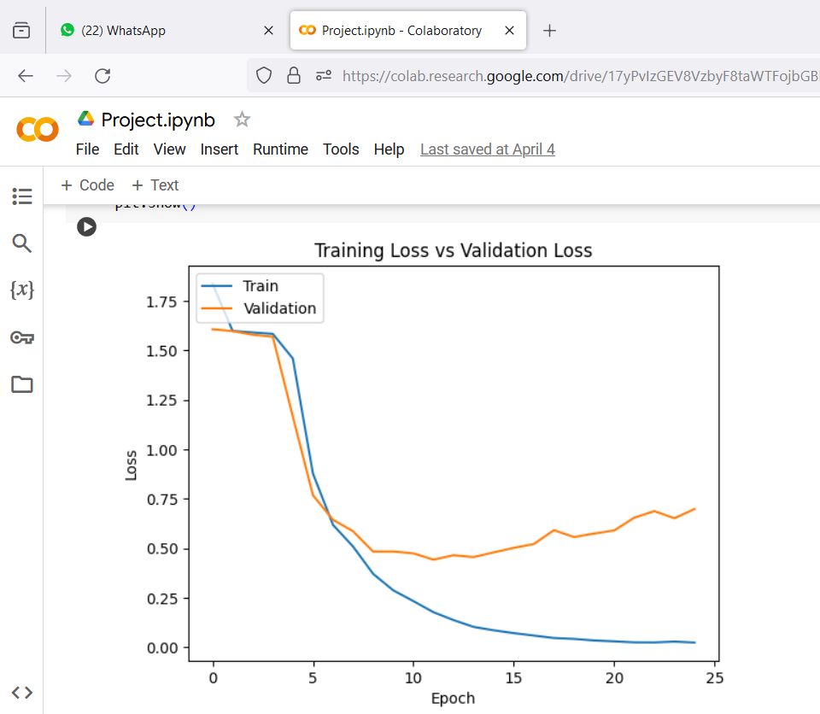
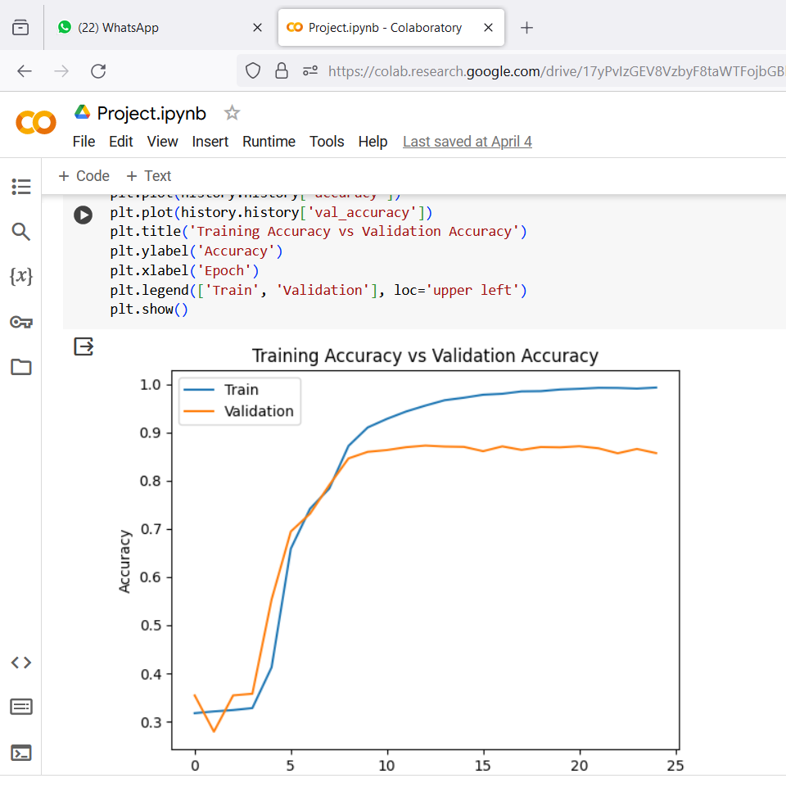
RESULTS

Slide 13
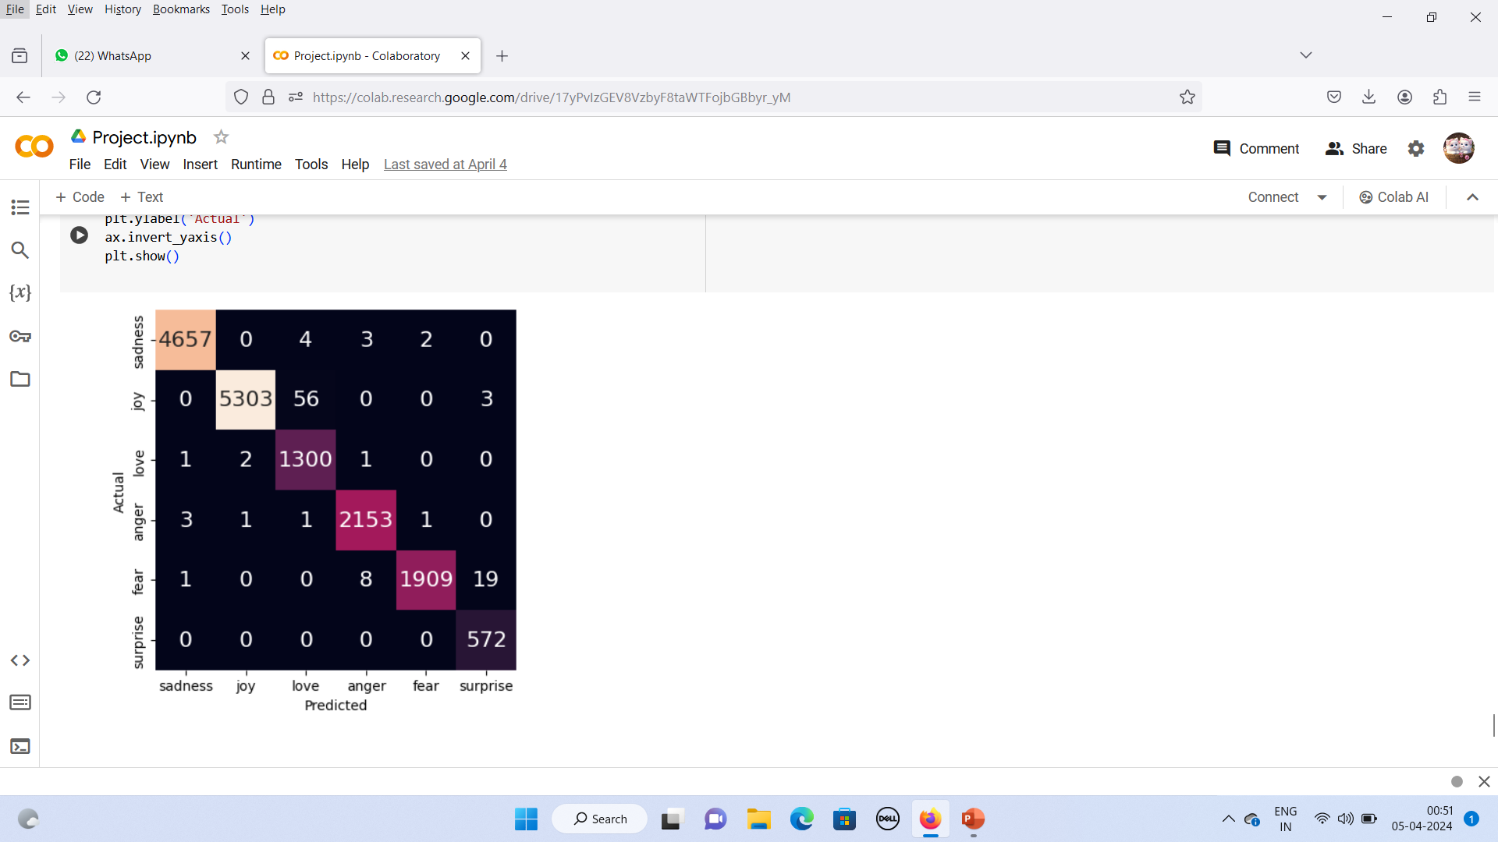
CONFUSION MATRIX

